Slide 1
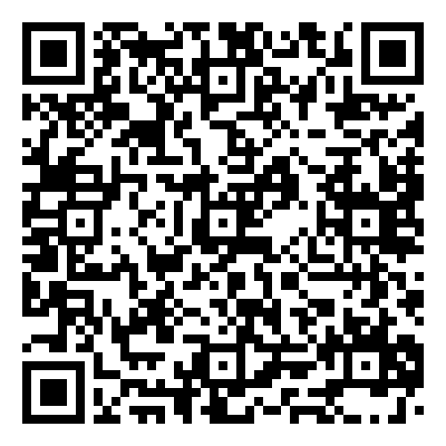
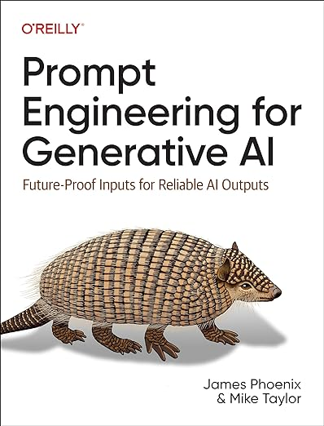
New Science Book Information from UNIV. CO-OP
Prompt Engineering for Generative AI:
Future-Proof Inputs for Reliable AI Outputs
※大学生協洋書オンラインストアの該当商品のページへ
2024年6月
刊行予定
Large language models (LLMs) and diffusion models such as ChatGPT and Stable Diffusion have unprecedented potential. Because they have been trained on all the public text and images on the internet, they can make useful contributions to a wide variety of tasks. And with the barrier to entry greatly reduced today, practically any developer can harness LLMs and diffusion models to tackle problems previously unsuitable for automation.
With this book, you'll gain a solid foundation in generative AI, including how to apply these models in practice. When first integrating LLMs and diffusion models into their workflows, most developers struggle to coax reliable enough results from them to use in automated systems. Authors James Phoenix and Mike Taylor show you how a set of principles called prompt engineering can enable you to work effectively with AI.
●著者Phoenix, James/Taylor, Mike
●出版社： O'Reilly Media
●ISBN：978-1-0981-5343-4
●刊行：2024年6月
● ｐaper/422P.
組合員価格は生協店舗にお尋ねください
＊海外からの仕入れのため為替レートの変動により価格は変動します。
研究費・科研費でのご購入は生協が便利で安心！
注文書
Prompt Engineering for Generative AI: ご注文 冊
氏名: TEL: お支払方法（○で囲む） 校費・私費
学部名； 学科名： 研究科or研究室名：
大学生協洋書オンラインストア:https://yosho.univcoop.jp/BookShop/
書籍ポータルサイト: https://online.univ.coop/book_front/
発行：2024年6月07日

